Slide 1

Classification of Harmful Farm Insects in Agriculture
Presented by
Annamalai Muthupalaniappan
Master of Science – Robotics
annamala@udel.edu
Disclaimer: You are about see a lot of images of insects, bugs and worms.

Slide 2
Abstract
Agriculture is one of the primary and critical sector that contributes enormously in local and global economies feeding the global population.
There are several challenges faced in the sector out of which a major threat is posed by harmful farm insects which can cause substantial damage to crops.
The traditional methods of control and identification is often a tiresome, manual effort and requires extensive use of labor and pesticides which are harmful to the environment and human health.
So, the objective of project is to integrate both sensing, data analytics (Machine learning) and innovative technologies to provide accurate, efficient classification of dangerous insects which helps in optimized pest control and increased yield and profitability.

Slide 3
OBJECTIVES
The primary objective of this project is to enable the development of a robust system capable of effectively detecting and classifying theses insects.
The implementation of such system holds an immense potential for pest control, benefiting both farms and residential areas alike.
The system safeguards crop quality by diminishing the pernicious effects caused by these insects thereby improving farmer’s earnings and impacting both overall economy and human health.

Slide 4
Materials :
Dataset:
The dataset is obtained from authentic site Kaggle. It consists of 1591 images of harmful insects which comprises 15 distinct species of insects.
The 15 classes are (Labels) Class 1 --> Africanized Honeybees (Killer Bees) Class 9 --> Corn Earworms Class 2 --> Aphids Class 10 --> Fall Armyworms
Class 3 --> Armyworms Class 11 --> Fruit Flies
Class 4 --> Brown Marmorated Stink Bugs Class 12 --> Spider Mites
Class 5 --> Cabbage Loopers Class 13 --> Thrips
Class 6 --> Citrus Canker Class 14 --> Tomato Hornworms
Class 7 --> Colorado Potato Beetles Class 15 --> Western Corn Rootworms
Class 8 --> Corn Borers

Slide 5
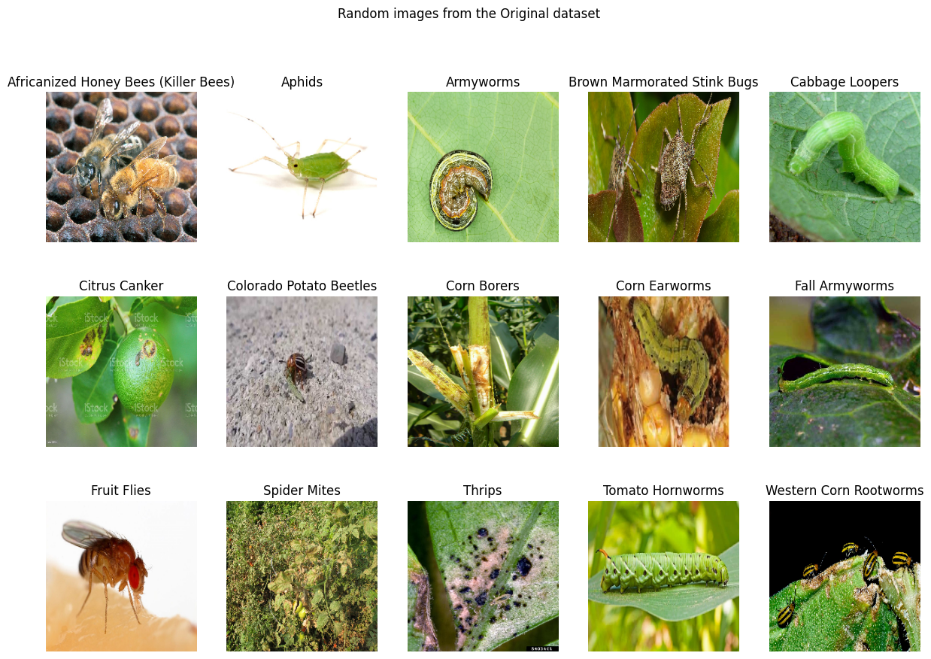

Slide 6
Methodologies Used:
Data preparation and pre-processing:
The dataset was split into
Training dataset : 70 % - (863 images)
Testing dataset : 15% - (274 images)
Validation dataset : 15% - (283 images)
The data was augmented and normalized to reduce complexity and enhance model generalization.
Then did exploratory data analysis by checking the data distribution.

Slide 7
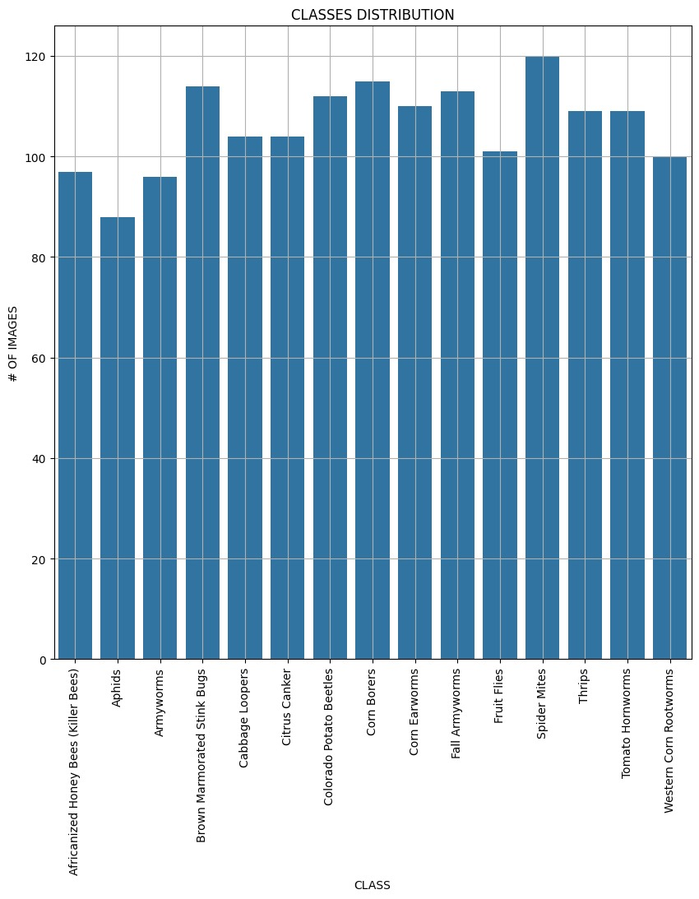
Exploratory Data Analysis:
Data Distribution :-

Slide 8
Data Augmentation and Normalization:
There was class imbalance observed in data distribution. So, To resolve that we are using class weights in training.
We can also use random under sampling or random oversampling. We can also increase the no. of data samples.
Random Images of dataset after pre-processing:

Slide 9
Methods and Models:
Model Training:
The following deep learning models that uses CNNs to implement transfer learning on my dataset were chosen.
Xception, VGG19, ResNet50V2, InceptionV3, MobileNetV2
These are the models that were used, tuned and predicted for the requirement. The models as follows
Notes:
Transfer Learning, took pre trained models and added dense layers and dropout layers.
Xception – inspired from inception architecture – also called Extreme inception – 71 layers
VGG19 – 19 layers
Inception – 48 MobileNet –
ResNet50V2 - 50

Slide 10
Results:
Model Evaluation:
Model | Test Accuracy | Validation Accuracy
Xception | 0.7491 | 0.7227
VGG19 | 0.1660 | 0.1328
ResNet50V2 | 0.6784 | 0.6914
InceptionV3 | 0.7561 | 0.7148
MobileNetV2 | 0.5547 | 0.5273

Slide 11
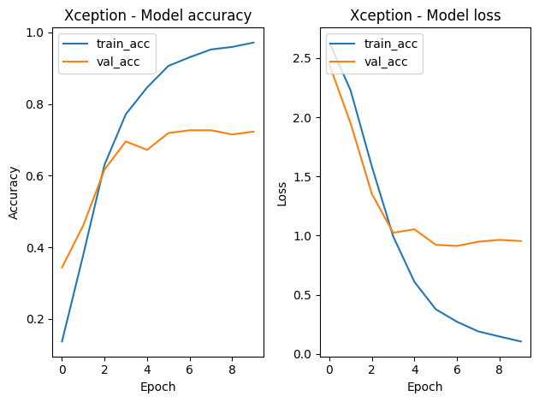
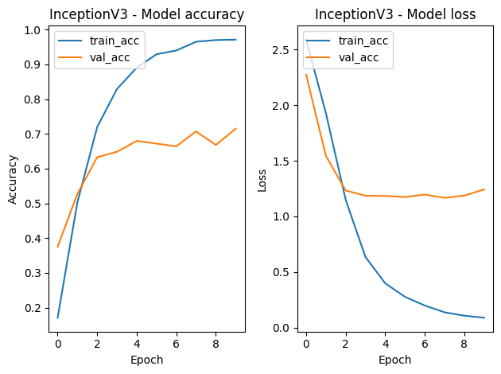
Evaluation:

Slide 12
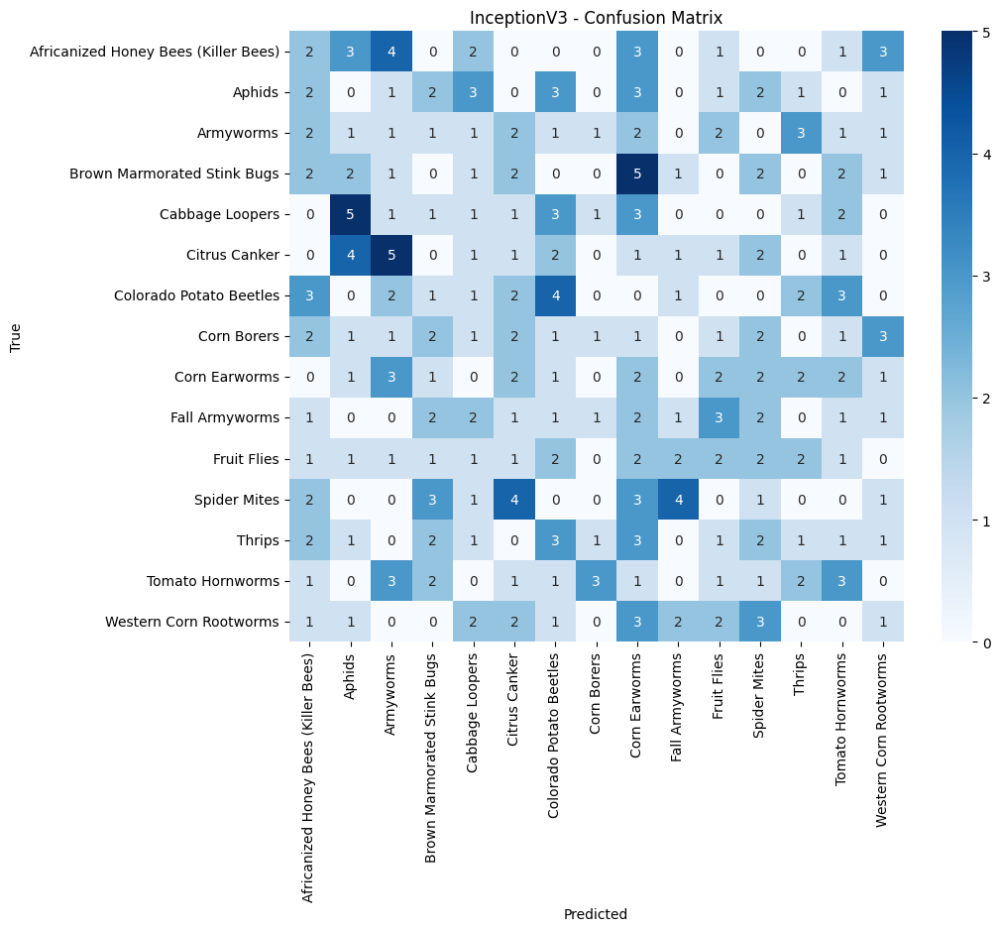
Evaluation:

Slide 13
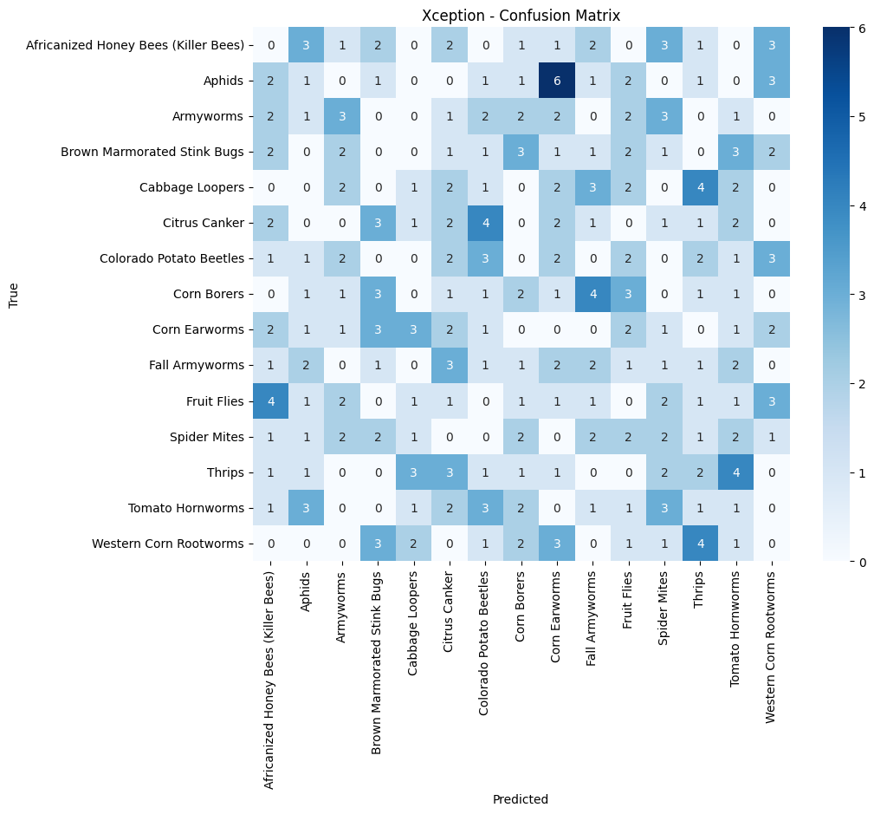
Evaluation:

Slide 14
Discussion:
Future Works :
We can further improve accuracy by Hyper – parameter tuning (Cross validation) or increase the count of dataset images.
We can also fine tune the model layers based on datasets and generalize and check their performance.
We can even combine two models and try to implement ensemble learning.
Conclusion :
I was able to finalize exception as my final model of all and built the system
Notes:
Cross Validation – 3 types Hyper band, Random search, Bayesian Optimization, Sklearn
Requires a lot of computational power
Fine tuning hyper parameters

Slide 15


Thank you all for Listening !
https://github.com/Anna02malai
annamala@udel.edu

